Slide 1
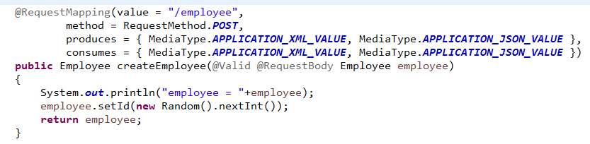
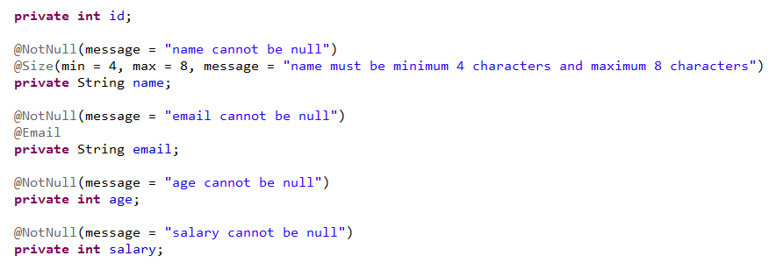
Validating HTTP POST Request Body

Slide 2
Validating HTTP POST Request Body
https://docs.jboss.org/hibernate/stable/validator/reference/en-US/html_single/#validator-defineconstraints-spec

